Slide 1
Chapter 6 Counting
Section 4
Binomial Coefficients

Slide 2
Outline
Basic Counting Principles
The Inclusion-Exclusion Principle
The Pigeonhole Principle
Ramsey number
Permutations
Combinations
Binomial Coefficients
Generalized Permutations
Combinations with Repetition

Slide 3
Binomial Coefficients
Binomial expression (二项式)
  A binomial expression is simply the sum of two terms, such as (x+y)
  The number of r-combinations from a set with n elements is often denoted by C(n, r). It is also called a binomial coefficient (二项式系数) as these numbers occur as coefficients in the expansion of powers of binomial expressions such as (a+b)^{n}

Slide 4
Binomial Coefficients
Example.
  The expansion of (x+y)³ can be found using combinational reasoning instead of multiplying the three terms out
  When (x+y)³ = (x+y)(x+y)(x+y) is expanded, all products of a term in the 1st sum (the first “x+y”), a term in the 2nd sum, and a term in the 3rd sum are added, e.g., x³, x²y, xy², and y³
  To obtain a term of the form x³, an x must be chosen in each of the sums, and this can be done in only one way. Thus, the x³ term in the product has a coefficient of 1
  To obtain a term of the form x²y, an x must be chosen in 2 of the 3 sums (and consequently a y in the other sum). Hence, the number of such terms is the number of 2-combinations of 3 objects, namely, C(3, 2)

Slide 5
Binomial Coefficients
  Similarly, the number of terms of the form xy² is the number of ways to pick 1 of the 3 sums to obtain an x (and consequently take a y from each of the other two sums), which can be done in C(3, 1) ways
  Consequently,
  (x+y)³ = (x+y)(x+y)(x+y)
  = (xx+xy+yx+yy)(x+y)
  = xxx+xxy+xyx+xyy+yxx+yxy+yyx+yyy
  = x³+3x²y+3x²+y³

Slide 6
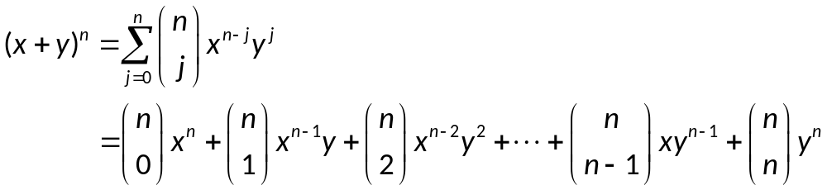
Binomial Coefficients
The Binomial Theorem. (二项式定理)
  Let x and y be variables, and let n be a nonnegative integer
  Proof.
  A combinatorial proof of the theorem is given. The terms in the product when it is expanded are of the form x^{n-j}y^{j} for j = 0, 1, 2, …, n
  To count the number of terms of the form x^{n-j}y^{j} , note that to obtain such a term it is necessary to choose n-j x’s from the n sums (so that the other j terms in the product are y’s). Therefore, the coefficients of x^{n-j}y^{j} is C(n, n-j) which is equal to C(n, j).

Slide 7
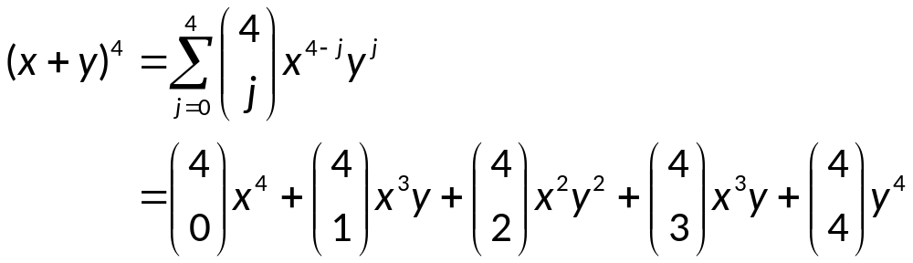
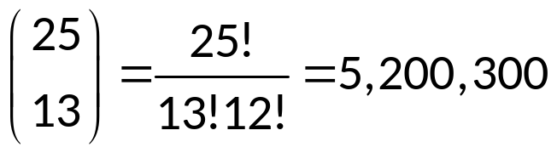
Binomial Coefficients
Example.
  By The Binomial Theorem, we have
Example.
  What is the coefficient of x¹²y¹³ in the expansion of (x+y)²⁵?
  Solution.

Slide 8
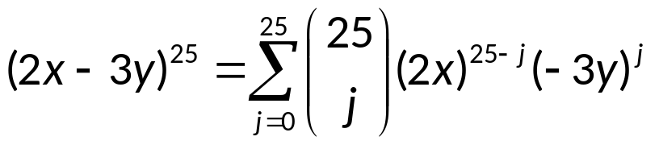
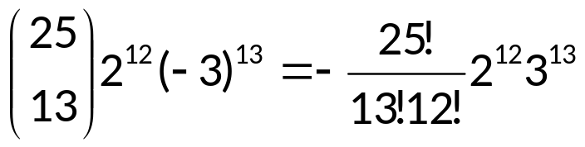
Binomial Coefficients
Example.
  What is the coefficient of x¹²y¹³ in the expansion of (2x-3y)²⁵?
  Solution.
  Consequently, the coefficient of x¹²y¹³ in the expansion of (2x-3y)²⁵ is

Slide 9
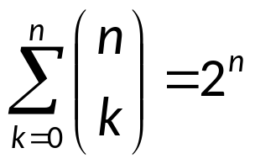
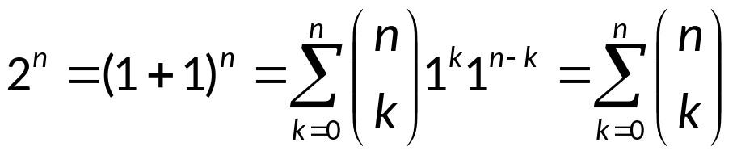
Binomial Coefficients
Corollary 1.
  Let n be a nonnegative integer. Then
  Proof.1.
  Using The Binomial Theorem with x = 1 and y = 1

Slide 10
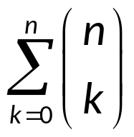
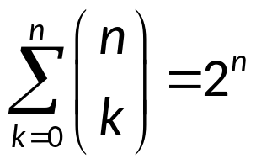
Binomial Coefficients
  Proof.2. (a combinatorial proof)
  A set with n elements has a total of 2^{n} different subsets. Each subset has 0 elements, 1 element, 2 elements, or n elements in it. Thus, there are C(n,0) subsets with 0 elements, C(n,1) subsets with 1 element, … and C(n,n) subsets with n elements. Thus counts the total number of a set with n elements,
  This shows that

Slide 11
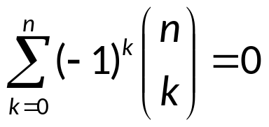
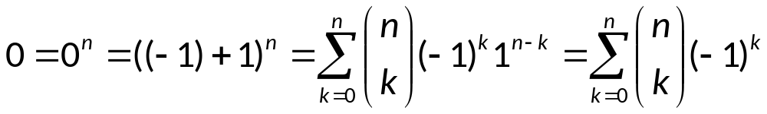
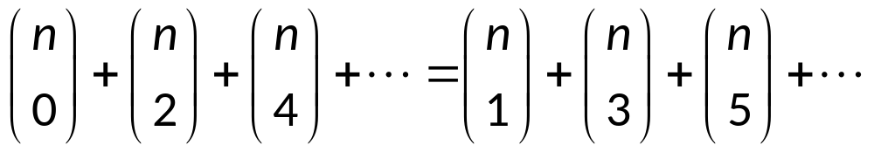
Binomial Coefficients
Corollary 2.
  Let n be a positive integer. Then
  Proof.
  Corollary 2 implies that:

Slide 12
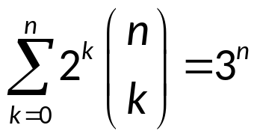
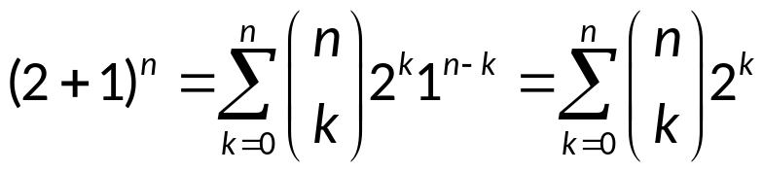
Binomial Coefficients
Corollary 3.
  Let n be a positive integer. Then
  Proof.
  Hence

Slide 13
Binomial Coefficients
Pascal’s identity. (1654, Blaise Pascal, 1623-1662)
  Let n and k be positive integers with n≥k. Then
  C(n+1, k) = C(n, k-1) + C(n, k)
  Proof.1. (combinatorial)
  Let T be a set containing n+1 elements. Let a be an element in T, and let S = T-{a} (Then S has n elements)
  Note that there are C(n+1, k) subsets of T containing k elements. However, a subset of T with k elements either contains a (It is a subset of k-1 elements of S) or not (It is a subset of k elements of S)
  There are C(n, k-1) subsets of k-1 elements of S, and so there are C(n, k-1) subsets of k elements of T containing a
  There are C(n, k) subsets of k elements of S, and so there are C(n, k) subset of k element of T that do not contain a
  Thus C(n+1, k) = C(n, k-1) + C(n, k)

Slide 14
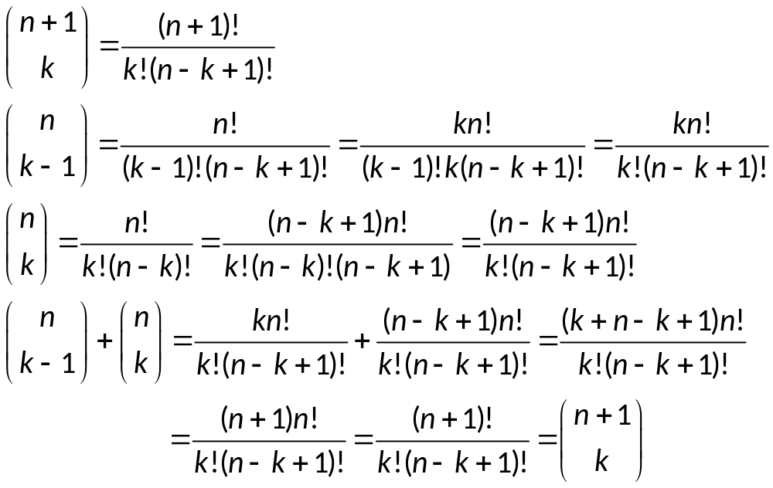
Binomial Coefficients
  Proof.2.
  The Pascal identity can also be proved with algebraic manipulation of

Slide 15
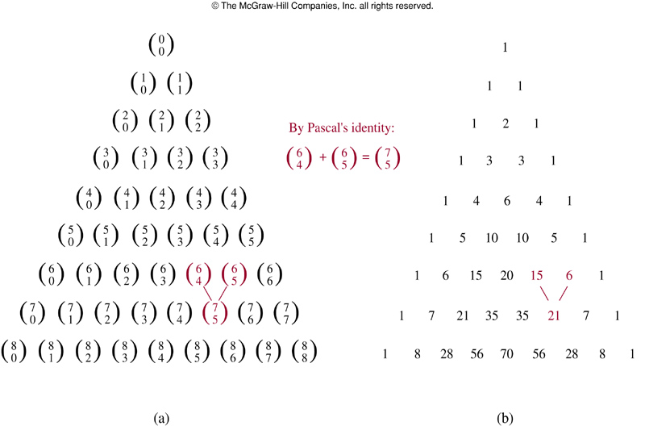
Binomial Coefficients
Remark.
  Pascal’s identity is the basis for a geometric arrangement of the binomial coefficients in a triangle
  贾宪, 北宋(1050年),《释锁算术》
  杨辉, 南宋(1261年),《详解九章算法》

Slide 16
Binomial Coefficients
  Pascal’s triangle / Chinese triangle

Slide 17
Assignment
Exercises.
  Exercises after 5.4: No.4, 15, 28. (Ver.6)

